Slide 1
WORLD OF DRONE
Drone Application: Journalism

Slide 2
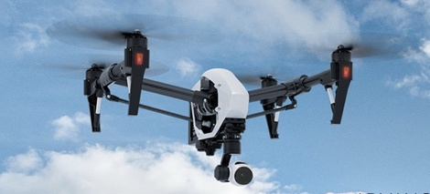
Drone Application: Journalism
Journalists are interested in using drones for news gathering and exploring hard and risk area to use a traditional equipment to capture video and audio.

Slide 3
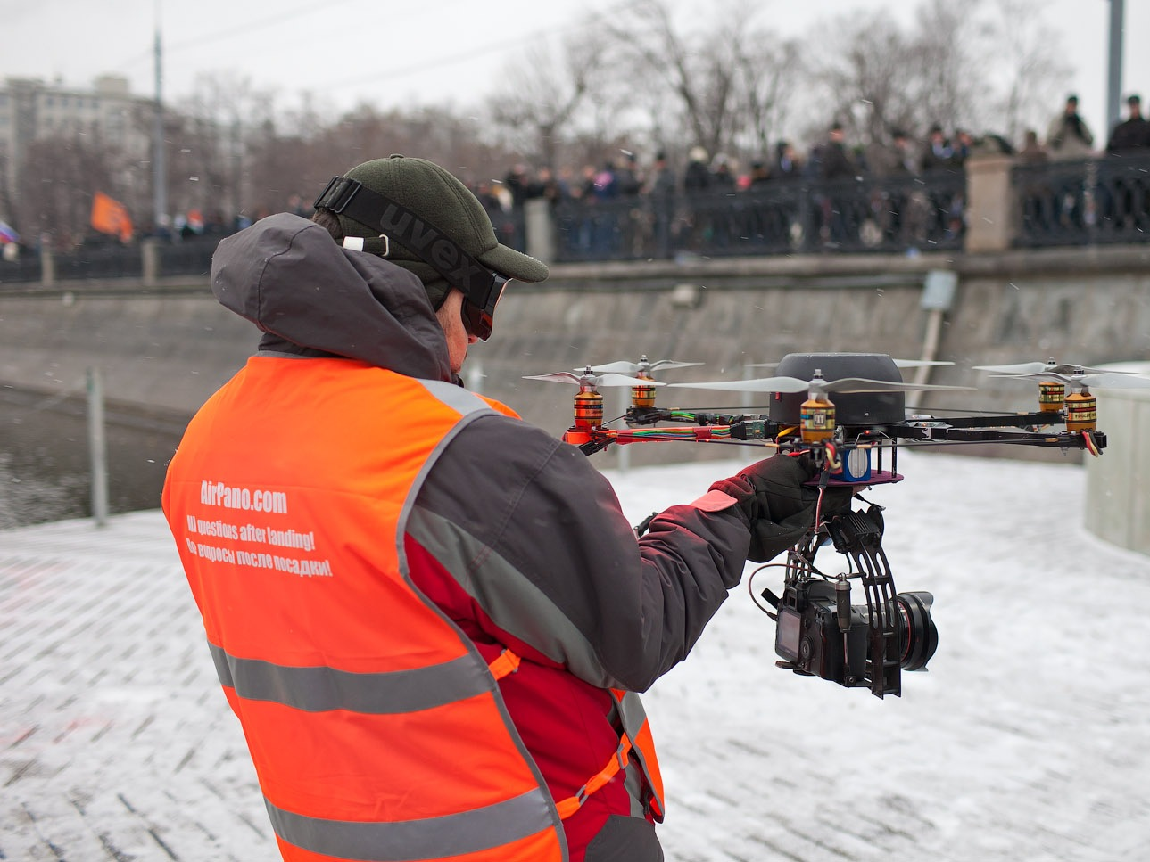
Drone Application: Journalism
For instance, drones have covered disasters such as typhoons to get images that are not possible or at least very hard to get without using drones.

Slide 4
Drones in Journalism Universities
The College of Journalism and Mass Communications at University of Nebraska-Lincoln established the Drone Journalism Lab.
University of Missouri created the Missouri Drone Journalism Program.

